Slide 1

Classical ML model vs Deep Learning
This project predicts Airbnb listing prices using advanced machine learning techniques and compares with MLP .
It covers data cleaning, feature engineering, model training, and evaluation.
Presented By: Kiran, Gowtham, Kowshigan

Slide 2
Dataset Overview and Cleaning Process
Dataset Size & Features
Data Cleaning Techniques
102,599 listings, 26 features initially recorded for analysis.
Handled missing values with median/mode imputation
After cleaning, dataset reduced to ~45,000 listings.
Dropped columns with >50% missing data
Removed outliers using Interquartile Range method

Slide 3
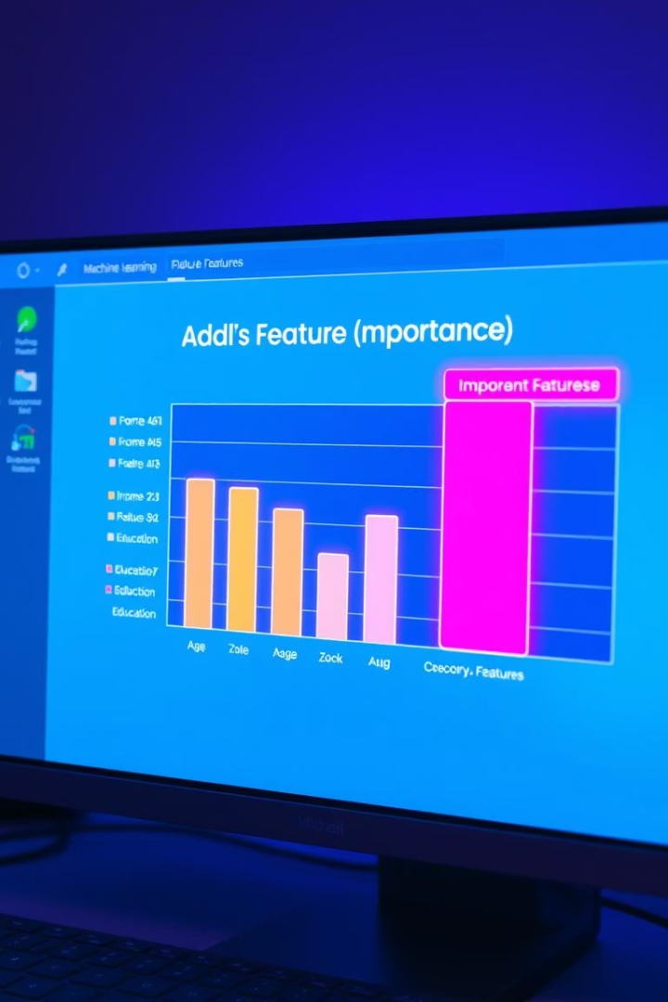
Feature Engineering & Selection
Encoding and Scaling
Encoded categorical variables and scaled numerical features with MinMaxScaler.
Top Features Selected by RFE
service fee
room type
minimum nights
number of reviews
reviews per month
review rate number
calculated host listings count
neighbourhood frequency encoded
latitude
instant bookable

Slide 4
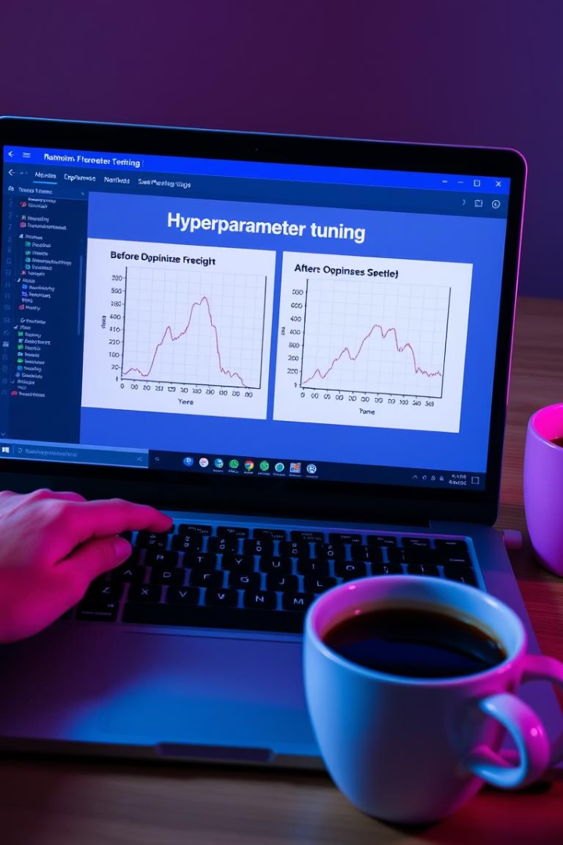
Random Forest Model Tuning Details
Hyperparameter Optimization
Used RandomizedSearchCV for tuning model parameters.
Best Parameters Found
n_estimators = 50
max_depth = 5
min_samples_split = 20
min_samples_leaf = 5
max_features = 'sqrt'
Performance
Reduced test MSE and improved R² with tuned hyperparameters.

Slide 5
Neural Network Architecture & Model Insights
Network Architecture
Training Strategies
Two hidden layers
Early stopping applied to prevent overfitting
Dropout and L2 regularization
Strong generalization on test data
Gaussian noise added

Slide 6
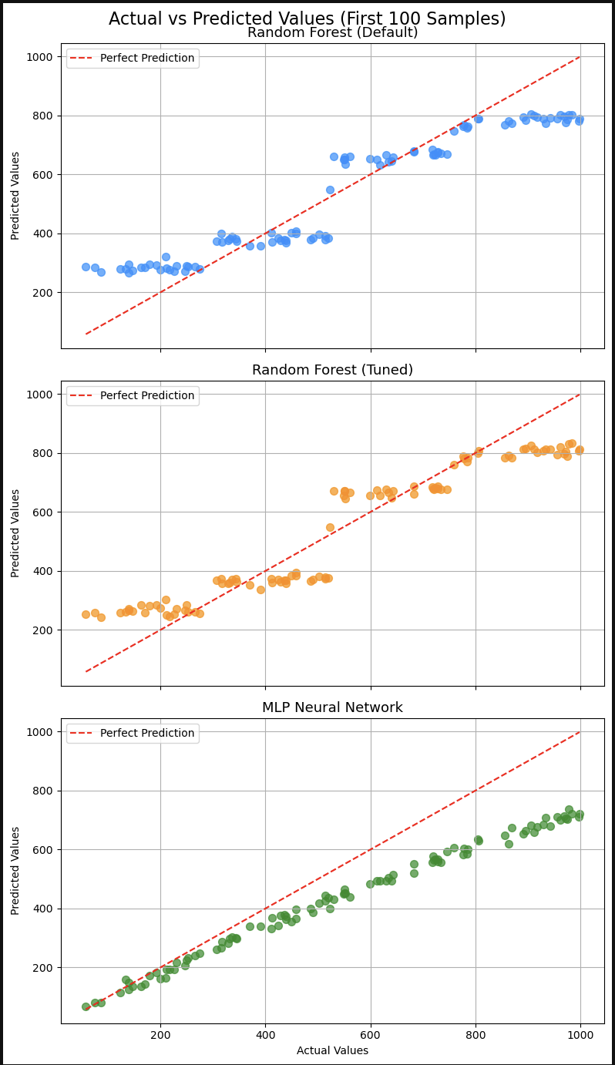
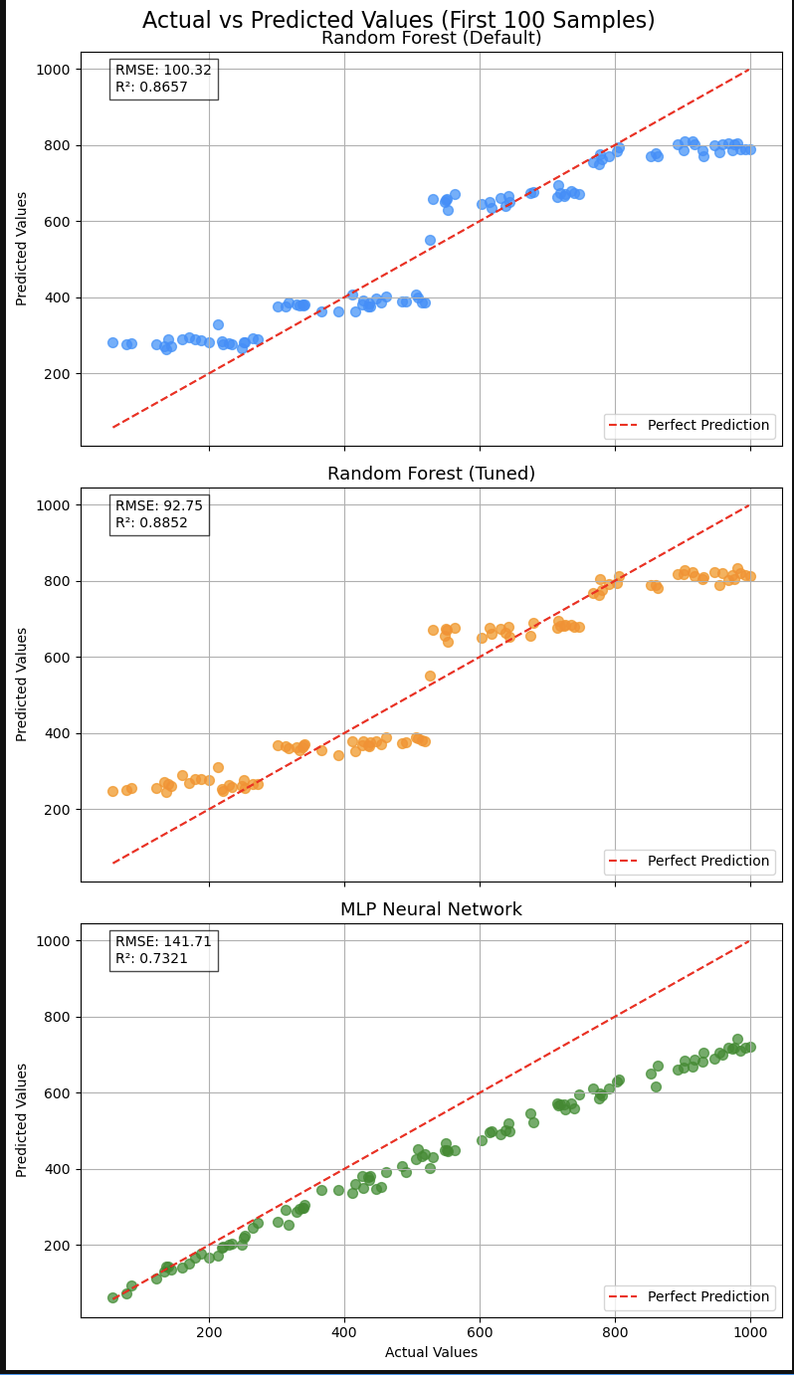
Model Training and Evaluation Metrics
Train RMSE
Train R²
Test RMSE
Test R²
Default Random Forest
98.66
0.8702
97.88
0.8701
Tuned Random Forest
90.98
0.8896
90.56
0.8888
MLP Neural Network
134.67
0.8606
134.17
0.8600

Slide 7
Conclusion
Built machine learning models to predict Airbnb listing prices with high accuracy.
Cleaned and preprocessed 45,000 listings from the original dataset of 102,599.
Selected top 10 important features using Recursive Feature Elimination (RFE).
Tuned Random Forest and MLP Neural Network both achieved strong R² scores.
Tuned Random Forest demonstrated the best generalization with no signs of overfitting.

Slide 8

Thank you

